Slide 1
Let’s do
Machine Learning

Slide 2
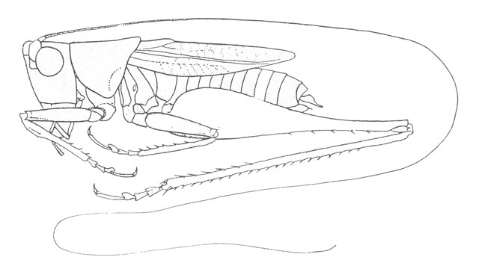
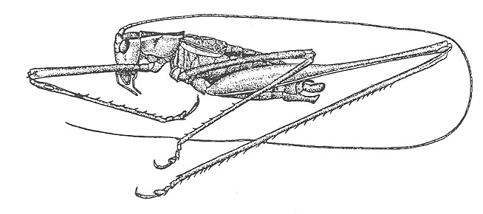
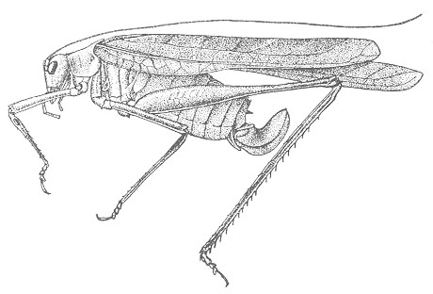
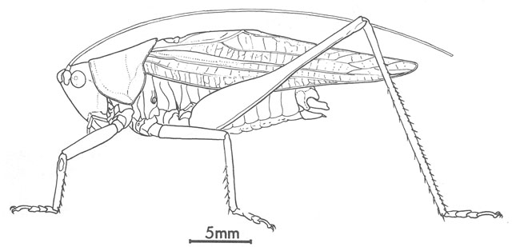
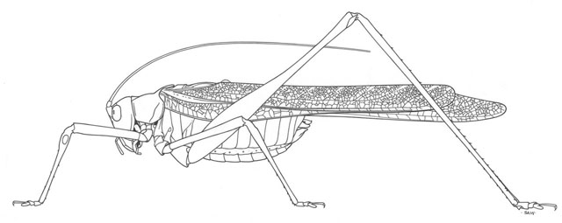
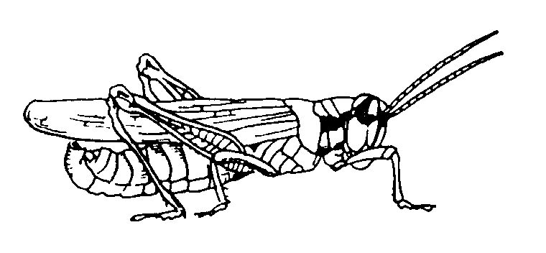
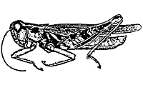
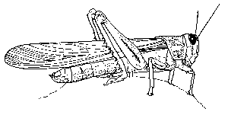
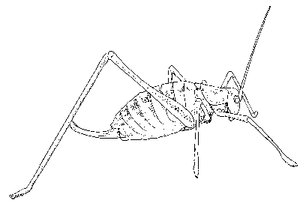
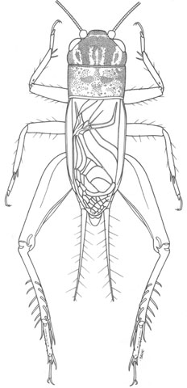
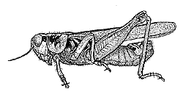
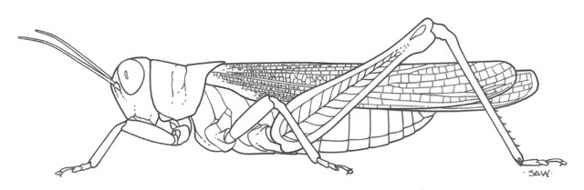
The Classification Problem
(informal definition)
Katydids
Given a collection of annotated data. In this case 5 instances Katydids of and five of Grasshoppers, decide what type of insect the unlabeled example is.
Grasshoppers
Katydid or Grasshopper?

Slide 3
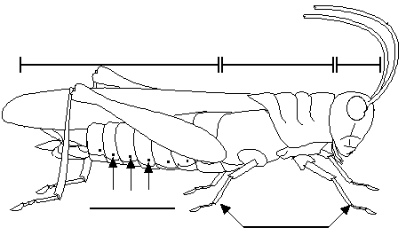
For any domain of interest, we can measure features
Color {Green, Brown, Gray, Other}
Has Wings?
Abdomen
Length
Thorax Length
Antennae
Length
Mandible
Size
Spiracle
Diameter
Leg Length

Slide 4
We can store features in a database.
My_Collection
Insect ID | Abdomen Length | Antennae Length | Insect Class
1 | 2.7 | 5.5 | Grasshopper
2 | 8.0 | 9.1 | Katydid
3 | 0.9 | 4.7 | Grasshopper
4 | 1.1 | 3.1 | Grasshopper
5 | 5.4 | 8.5 | Katydid
6 | 2.9 | 1.9 | Grasshopper
7 | 6.1 | 6.6 | Katydid
8 | 0.5 | 1.0 | Grasshopper
9 | 8.3 | 6.6 | Katydid
10 | 8.1 | 4.7 | Katydids
The classification problem can now be expressed as:
Given a training database (My_Collection), predict the class label of a previously unseen instance
previously unseen instance =
11 | 5.1 | 7.0 | ???????

Slide 5
Grasshoppers
Katydids
10
9
8
7
6
Antenna Length
5
4
3
2
1
1
2
3
4
5
6
7
8
9
10
Abdomen Length

Slide 6
Grasshoppers
Katydids
We will also use this lager dataset as a motivating example…
10
9
8
7
6
Antenna Length
5
Each of these data objects are called…
exemplars
(training) examples
instances
tuples
4
3
2
1
1
2
3
4
5
6
7
8
9
10
Abdomen Length

Slide 7

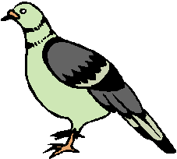
We will return to the previous slide in two minutes. In the meantime, we are going to play a quick game.
I am going to show you some classification problems which were shown to pigeons!
Let us see if you are as smart as a pigeon!

Slide 8
Pigeon Problem 1
Examples of class A
Examples of class B
3 4
5 2.5
1.5 5
5 2
6 8
8 3
2.5 5
4.5 3

Slide 9


Pigeon Problem 1
What class is this object?
Examples of class A
Examples of class B
3 4
5 2.5
8 1.5
What about this one, A or B?
1.5 5
5 2
6 8
8 3
4.5 7
2.5 5
4.5 3

Slide 10

Pigeon Problem 1
This is a B!
Examples of class A
Examples of class B
3 4
5 2.5
8 1.5
1.5 5
5 2
Here is the rule.
If the left bar is smaller than the right bar, it is an A, otherwise it is a B.
6 8
8 3
2.5 5
4.5 3

Slide 11


Pigeon Problem 2
Oh! This ones hard!
Examples of class A
Examples of class B
4 4
5 2.5
8 1.5
Even I know this one
5 5
2 5
6 6
5 3
7 7
3 3
2.5 3

Slide 12

Pigeon Problem 2
Examples of class A
Examples of class B
The rule is as follows, if the two bars are equal sizes, it is an A. Otherwise it is a B.
4 4
5 2.5
5 5
2 5
So this one is an A.
6 6
5 3
7 7
3 3
2.5 3

Slide 13

Pigeon Problem 3
Examples of class A
Examples of class B
6 6
4 4
5 6
This one is really hard!
What is this, A or B?
1 5
7 5
6 3
4 8
3 7
7 7

Slide 14

Pigeon Problem 3
It is a B!
Examples of class A
Examples of class B
6 6
4 4
5 6
The rule is as follows, if the square of the sum of the two bars is less than or equal to 100, it is an A. Otherwise it is a B.
1 5
7 5
6 3
4 8
3 7
7 7

Slide 15
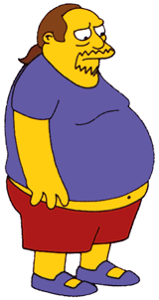

Why did we spend so much time with this game?
Because we wanted to show that almost all classification problems have a geometric interpretation, check out the next 3 slides…

Slide 16
Pigeon Problem 1
10
9
8
Examples of class A
Examples of class B
7
6
Left Bar
5
4
3
2
3 4
5 2.5
1
1
2
3
4
5
6
7
8
9
10
Right Bar
1.5 5
5 2
Here is the rule again.
If the left bar is smaller than the right bar, it is an A, otherwise it is a B.
6 8
8 3
2.5 5
4.5 3

Slide 17

Pigeon Problem 2
10
9
8
Examples of class A
Examples of class B
7
6
Left Bar
5
4
3
2
4 4
5 2.5
1
1
2
3
4
5
6
7
8
9
10
Right Bar
5 5
2 5
Let me look it up… here it is.. the rule is, if the two bars are equal sizes, it is an A. Otherwise it is a B.
6 6
5 3
3 3
2.5 3

Slide 18

Pigeon Problem 3
100
90
80
Examples of class A
Examples of class B
70
60
Left Bar
50
40
30
20
4 4
5 6
10
10
20
30
40
50
60
70
80
90
100
Right Bar
1 5
7 5
6 3
4 8
The rule again:
if the square of the sum of the two bars is less than or equal to 100, it is an A. Otherwise it is a B.
3 7
7 7

Slide 19
Grasshoppers
Katydids
10
9
8
7
6
Antenna Length
5
4
3
2
1
1
2
3
4
5
6
7
8
9
10
Abdomen Length

Slide 20
previously unseen instance =
11 | 5.1 | 7.0 | ???????
We can “project” the previously unseen instance into the same space as the database.
We have now abstracted away the details of our particular problem. It will be much easier to talk about points in space.
10
9
8
7
6
Antenna Length
5
4
3
2
1
Katydids
Grasshoppers
1
2
3
4
5
6
7
8
9
10
Abdomen Length

Slide 21
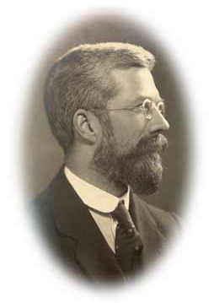
Simple Linear Classifier
10
9
8
7
R.A. Fisher
1890-1962
6
5
If previously unseen instance above the line
then
class is Katydid
else
class is Grasshopper
4
3
2
1
Katydids
Grasshoppers
1
2
3
4
5
6
7
8
9
10

Slide 22


The simple linear classifier is defined for higher dimensional spaces…

Slide 23
… we can visualize it as being an n-dimensional hyperplane

Slide 24
It is interesting to think about what would happen in this example if we did not have the 3rd dimension…

Slide 25
We can no longer get perfect accuracy with the simple linear classifier…
We could try to solve this problem by user a simple quadratic classifier or a simple cubic classifier..
However, as we will later see, this is probably a bad idea…

Slide 26
Which of the “Pigeon Problems” can be solved by the Simple Linear Classifier?
10
9
8
7
6
Perfect
Useless
Pretty Good
5
4
3
2
1
1
2
3
4
5
6
7
8
9
10
100
10
90
9
Problems that can be solved by a linear classifier are call linearly separable.
80
8
70
7
60
6
50
5
40
4
30
3
20
2
10
1
10
20
30
40
50
60
70
80
90
100
1
2
3
4
5
6
7
8
9
10

Slide 27
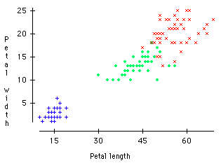
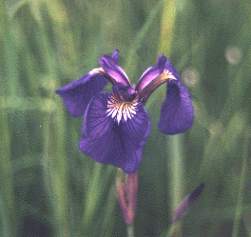
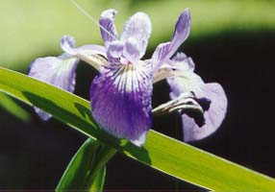
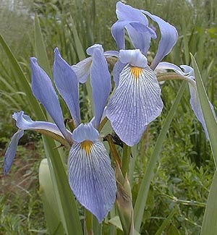
Virginica
A Famous Problem
R. A. Fisher’s Iris Dataset.
3 classes
50 of each class
The task is to classify Iris plants into one of 3 varieties using the Petal Length and Petal Width.
Setosa
Versicolor
Iris Setosa
Iris Versicolor
Iris Virginica

Slide 28
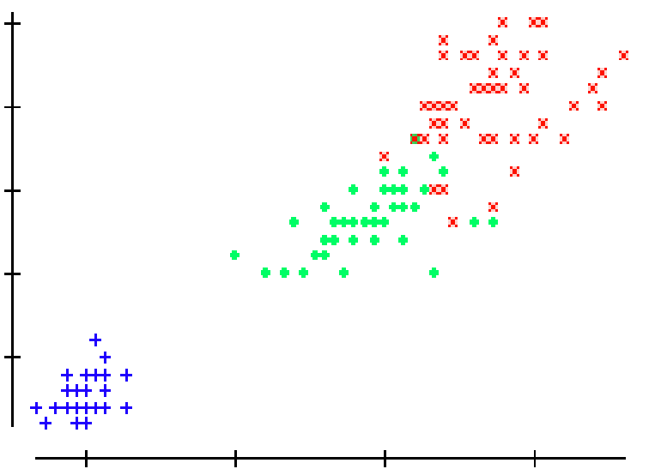
We can generalize the piecewise linear classifier to N classes, by fitting N-1 lines. In this case we first learned the line to (perfectly) discriminate between Setosa and Virginica/Versicolor, then we learned to approximately discriminate between Virginica and Versicolor.
Virginica
Setosa
Versicolor
If petal width > 3.272 – (0.325 * petal length) then class = Virginica
Elseif petal width…

Slide 29
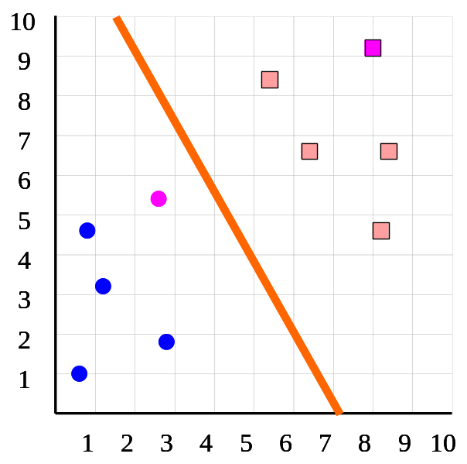
Predictive Accuracy I
How do we estimate the accuracy of our classifier?
  We need a TESTING dataset that the classifier never saw before
Number of correct classifications
Number of instances in our database
Accuracy =
Insect ID | Abdomen Length | Antennae Length | Insect Class
1 | 2.7 | 5.5 | Grasshopper
2 | 8.0 | 9.1 | Katydid
3 | 0.9 | 4.7 | Grasshopper
4 | 1.1 | 3.1 | Grasshopper
5 | 5.4 | 8.5 | Katydid
6 | 2.9 | 1.9 | Grasshopper
7 | 6.1 | 6.6 | Katydid
8 | 0.5 | 1.0 | Grasshopper
9 | 8.3 | 6.6 | Katydid
10 | 8.1 | 4.7 | Katydids

Slide 30
Predictive Accuracy II
Number of correct classifications
Number of instances in our database
Accuracy =
Accuracy is a single number, we may be better off looking at a confusion matrix. This gives us additional useful information…
True label is...
 | Cat | Dog | Pig
Cat | 100 | 0 | 0
Dog | 9 | 90 | 1
Pig | 45 | 45 | 10
Classified as a…

Slide 31
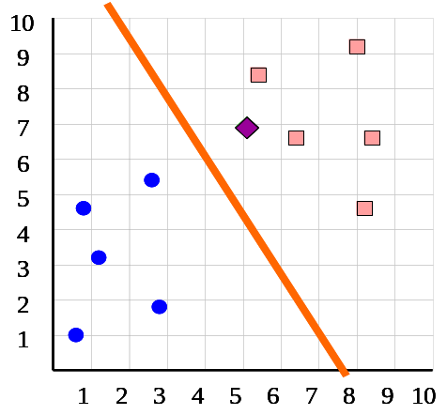
Speed and Scalability I
We need to consider the time and space requirements for the two distinct phases of classification:
  Time to construct the classifier
    In the case of the simpler linear classifier, the time taken to fit the line, this is linear in the number of instances.
  Time to use the model
    In the case of the simpler linear classifier, the time taken to test which side of the line the unlabeled instance is. This can be done in constant time.
As we shall see, some classification algorithms are very efficient in one aspect, and very poor in the other.

Slide 32
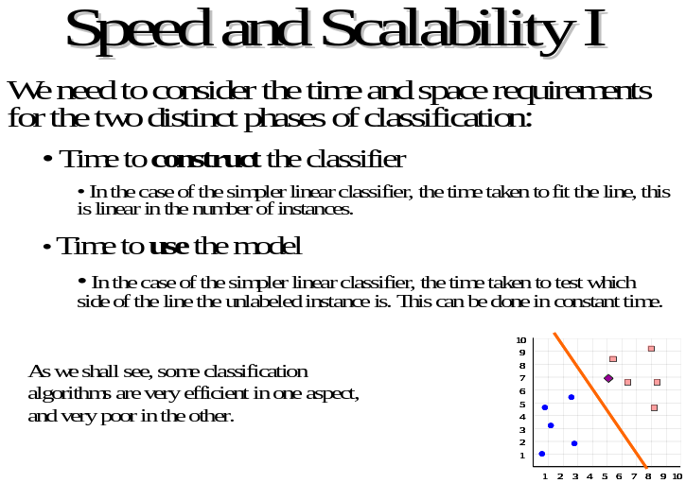
Speed and Scalability II
For learning with small datasets, this is the whole picture
However, for data mining with massive datasets, it is not so much the (main memory) time complexity that matters, rather it is how many times we have to scan the database.
This is because for most data mining operations, disk access times completely dominate the CPU times.
For data mining, researchers often report the number of times you must scan the database.

Slide 33
Interpretability
Some classifiers offer a bonus feature. The structure of the learned classifier tells use something about the domain.
As a trivial example, if we try to classify peoples health risks based on just their height and weight, we could gain the following insight (Based of the observation that a single linear classifier does not work well, but two linear classifiers do).
There are two ways to be unhealthy, being obese and being too skinny.
Weight
Height

Slide 34

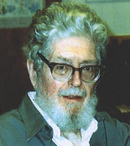
Nearest Neighbor Classifier
10
9
8
7
Evelyn Fix
1904-1965
Joe Hodges
1922-2000
6
Antenna Length
5
If the nearest instance to the previously unseen instance is a Katydid
class is Katydid
else
class is Grasshopper
4
3
2
1
Katydids
Grasshoppers
1
2
3
4
5
6
7
8
9
10
Abdomen Length

Slide 35
We can visualize the nearest neighbor algorithm in terms of a decision surface…
Note the we don’t actually have to construct these surfaces, they are simply the implicit boundaries that divide the space into regions “belonging” to each instance.
This division of space is called Dirichlet Tessellation (or Voronoi diagram, or Theissen regions).

Slide 36
The nearest neighbor algorithm is sensitive to outliers…
The solution is to…

Slide 37
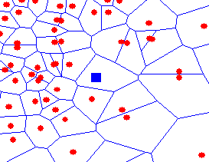
We can generalize the nearest neighbor algorithm to the K- nearest neighbor (KNN) algorithm.
We measure the distance to the nearest K instances, and let them vote. K is typically chosen to be an odd number.
K = 1
K = 3

Slide 38
Real classifiers are more complex
Based on various statistical techniques
All classifiers can be seen as a black box
Unseen testing instance with unknown label
Training Instances with known label
Trained classifier
Estimated label

Slide 39
The nearest neighbor algorithm is sensitive to irrelevant features…
Suppose the following is true, if an insects antenna is longer than 5.5 it is a Katydid, otherwise it is a Grasshopper.
Using just the antenna length we get perfect classification!
Training data
1
2
3
4
5
6
7
8
9
10
6
1
2
3
4
5
6
7
8
9
10
1
2
3
4
5
6
7
8
9
10
5
10
Suppose however, we add in an irrelevant feature, for example the insects mass.
Using both the antenna length and the insects mass with the 1-NN algorithm we get the wrong classification!
9
8
7
6
5
4
3
2
1
1
2
3
4
5
6
7
8
9
10
1
2
3
4
5
6
7
8
9
10

Slide 40
How do we mitigate the nearest neighbor algorithms sensitivity to irrelevant features?
Use more training instances
Ask an expert what features are relevant to the task
Use statistical tests to try to determine which features are useful
Search over feature subsets (in the next slide we will see why this is hard)

Slide 41
Why searching over feature subsets is hard
Suppose you have the following classification problem, with 100 features, where is happens that Features 1 and 2 (the X and Y below) give perfect classification, but all 98 of the other features are irrelevant…
Only Feature 2
Only Feature 1
Using all 100 features will give poor results, but so will using only Feature 1, and so will using Feature 2! Of the 2¹⁰⁰ –1 possible subsets of the features, only one really works.

Slide 42
1
2
3
4
1,2
1,3
2,3
1,4
2,4
3,4
1,2,3
1,2,4
1,3,4
2,3,4
Forward Selection
Backward Elimination
Bi-directional Search
1,2,3,4

Slide 43
The nearest neighbor algorithm is sensitive to the units of measurement
X axis measured in centimeters
Y axis measure in dollars
The nearest neighbor to the pink unknown instance is red.
X axis measured in millimeters
Y axis measure in dollars
The nearest neighbor to the pink unknown instance is blue.
One solution is to normalize the units to pure numbers. Typically the features are Z-normalized to have a mean of zero and a standard deviation of one. X = (X – mean(X))/std(x)

Slide 44
We can speed up nearest neighbor algorithm by “throwing away” some data. This is called data editing.
Note that this can sometimes improve accuracy!
We can also speed up classification with indexing
One possible approach. Delete all instances that are surrounded by members of their own class.

Slide 45
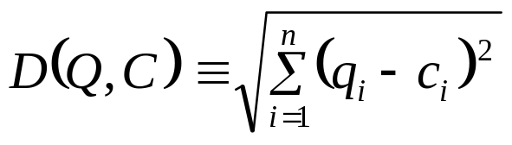
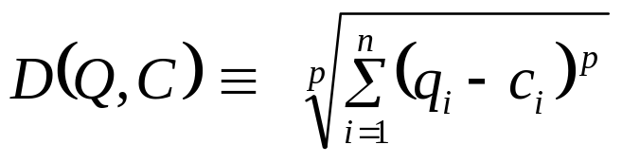
Up to now we have assumed that the nearest neighbor algorithm uses the Euclidean Distance, however this need not be the case…
10
9
Max (p=inf)
8
7
6
Manhattan (p=1)
5
4
Weighted Euclidean
3
2
1
Mahalanobis
1
2
3
4
5
6
7
8
9
10

Slide 46
…In fact, we can use the nearest neighbor algorithm with any distance/similarity function
For example, is “Faloutsos” Greek or Irish? We could compare the name “Faloutsos” to a database of names using string edit distance…
edit_distance(Faloutsos, Keogh) = 8
edit_distance(Faloutsos, Gunopulos) = 6
Hopefully, the similarity of the name (particularly the suffix) to other Greek names would mean the nearest nearest neighbor is also a Greek name.
ID | Name | Class
1 | Gunopulos | Greek
2 | Papadopoulos | Greek
3 | Kollios | Greek
4 | Dardanos | Greek
5 | Keogh | Irish
6 | Gough | Irish
7 | Greenhaugh | Irish
8 | Hadleigh | Irish
Specialized distance measures exist for DNA strings, time series, images, graphs, videos, sets, fingerprints etc…

Slide 47
Edit Distance Example
How similar are the names “Peter” and “Piotr”?
Assume the following cost function
Substitution 1 Unit
Insertion 1 Unit
Deletion 1 Unit
D(Peter,Piotr) is 3
It is possible to transform any string Q into string C, using only Substitution, Insertion and Deletion.
Assume that each of these operators has a cost associated with it.
The similarity between two strings can be defined as the cost of the cheapest transformation from Q to C.
Note that for now we have ignored the issue of how we can find this cheapest transformation
Peter
Piter
Pioter
Piotr
Substitution (i for e)
Insertion (o)
Piotr
Pedro
Piero
Peter
Deletion (e)
Pyotr
Petros
Pietro
Pierre

